Slide 1


Positioning In Internet of Things (IoT)
Uttej Reddy Pakanati Jaya Sriram Ganeshna
urpakanati@uwaterloo.ca jsganesh@uwaterloo.ca
20875894 20915835
ECE 655 Presentation

Slide 2
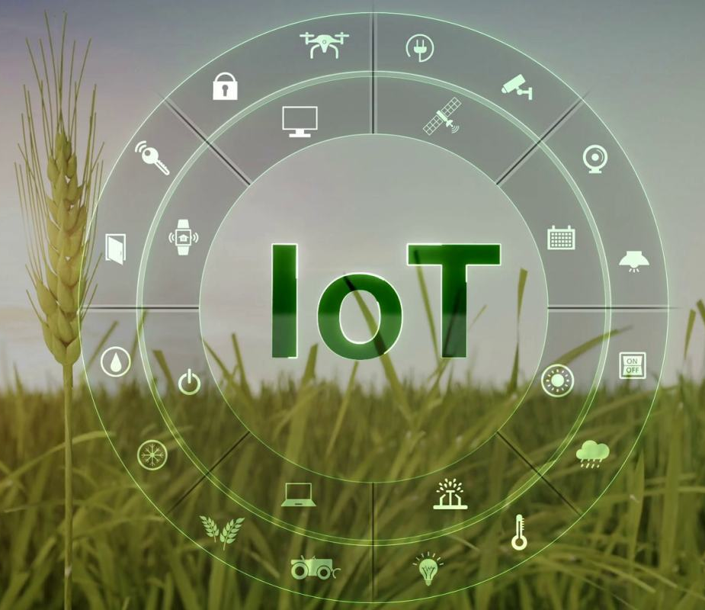
Contents
What is IoT?
Applications of IoT
LoRa, LTE-M & NB-IoT
How positioning is achieved?
Design Challenges
How positioning is enhanced?
Conclusion

Slide 3
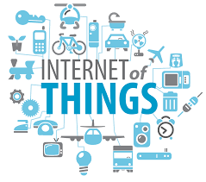
What is Internet of Things (IoT)?
In IoT, various devices are connected over the internet, and they communicate data with each other to make informed decisions.
The IoT is a vision of a future world where everything that can benefit from a connection will be connected.

Slide 4



Applications of IoT
Smart Agriculture
Wearables
Animal Husbandry

Slide 5
LoRa, LTE-M & NB-IoT
LoRa - The Long-Range (LoRa) modulation is based on Chirp Spread Spectrum (CSS) signals and has become popular for wide-area Internet of Things (IoT) applications due to the operation in unlicensed spectrum (typically 868 MHz in Europe and 915 MHz in North America), its energy efficiency and low cost.
LTE-M - Long-Term Evolution (LTE) MTC (LTE-M) is a type of low power wide area network (LPWAN) radio technology standard developed by 3GPP to enable a wide range of cellular devices and services. IoT devices can transmit and receive large quantities of data without draining the battery by using LTE-M.
NB-IoT - NarrowBand-Internet of Things (NB-IoT) is a low power wide area (LPWA) standard technology developed by 3GPP for cellular devices and services. It focuses specifically on low cost, spectrum efficiency, indoor coverage, long battery life of more than ten years, and high connection density.

Slide 6
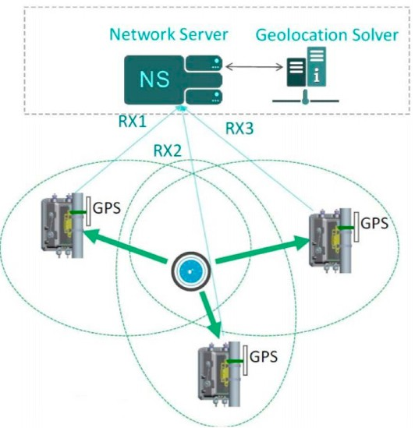
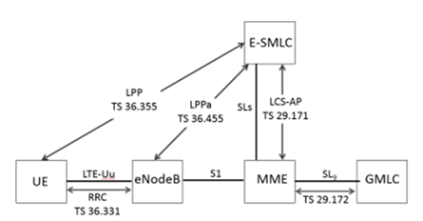
How positioning is achieved?
LoRa
LTE-M & NB-IoT

Slide 7


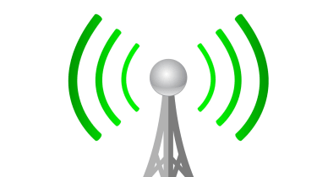
Design Challenges
LoRa
Energy Consumption
Security
LTE-M & NB-IoT
Limited Device Capability
Coverage Extension

Slide 8
How positioning is enhanced?
LoRa - particle filter localization can be used to solve the problem of ranging error caused by multipath in indoor positioning. Positioning accuracy can be enhanced with the help of the piecewise fitting correction technique. Simultaneously, the LoRa indoor positioning system can achieve a positioning accuracy of 1m under the condition of the line of sight (LOS).
LTE-M - PRS signals design is done to improve OTDOA support for LTE-M.
The PRS sequence of LTE is a pseudo-random Quadrature Phase Shift Keying sequence, and LTE-M uses the same PRS sequence.
The elements from the PRS sequence are mapped to resource elements determined by physical cell identity.
By generating and mapping sequences repeatedly, PRS sequences are generated, which change with time.

Slide 9
How positioning is enhanced?
NB-IoT- PRS signals design is done to improve OTDOA support for NB-IoT.
The NPRS bitmap length is considered as the NPRS positioning occasions period, and every NPRS period can be regarded as a positioning occasion, while the NPRS bitmap indicates the subframes used for NPRS.
NPRS sequence also uses LTE PRS sequence where the central two elements of the LTE PRS sequence are used as NPRS sequences in standalone or guard band deployment.
NPRS muting enables the efficient detectability of the PRS from the weak entity, which shares the same frequency shift with strong cell PRS.

Slide 10
Conclusion
This literature review discussed the positioning, drawbacks, and enhanced positioning of LoRa, NB-IoT, and LTE-M.
We expect that research in this direction will gain much more attention soon since the implementation of IoT systems involves the networking of LoRa and an end-to-end system development up to the application layer.
Also, LTE-M and NB-IoT devices are expected to have a long lifecycle that may go beyond the network evolution of 5G.
It will be beneficial for future 5G positioning if they are designed by combining with LTE-M or NB-IoT positioning.

Slide 11
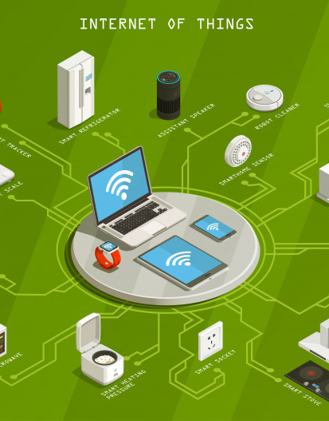
Thank you

